Slide 1
Data in Museums
Coming full circle from data and metadata origination and curation, to its use in research

Slide 2
This semester we have explored
Data Standards
Data/Content Management Systems
Relational Databases
Data Collection
Data Processing
Enriching Records
Georeferencing, Image Metadata
Dataset Curation
Data Management

Slide 3

How does all this well curated data help science?
Data papers
Data use/research
Reproducible research

Slide 4
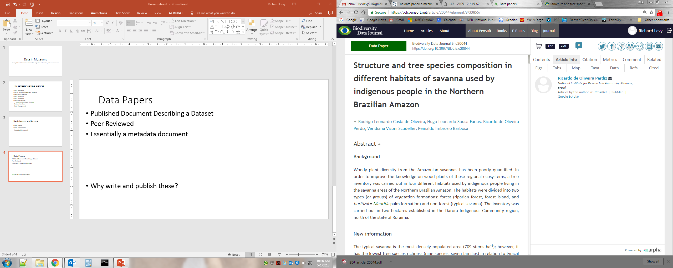
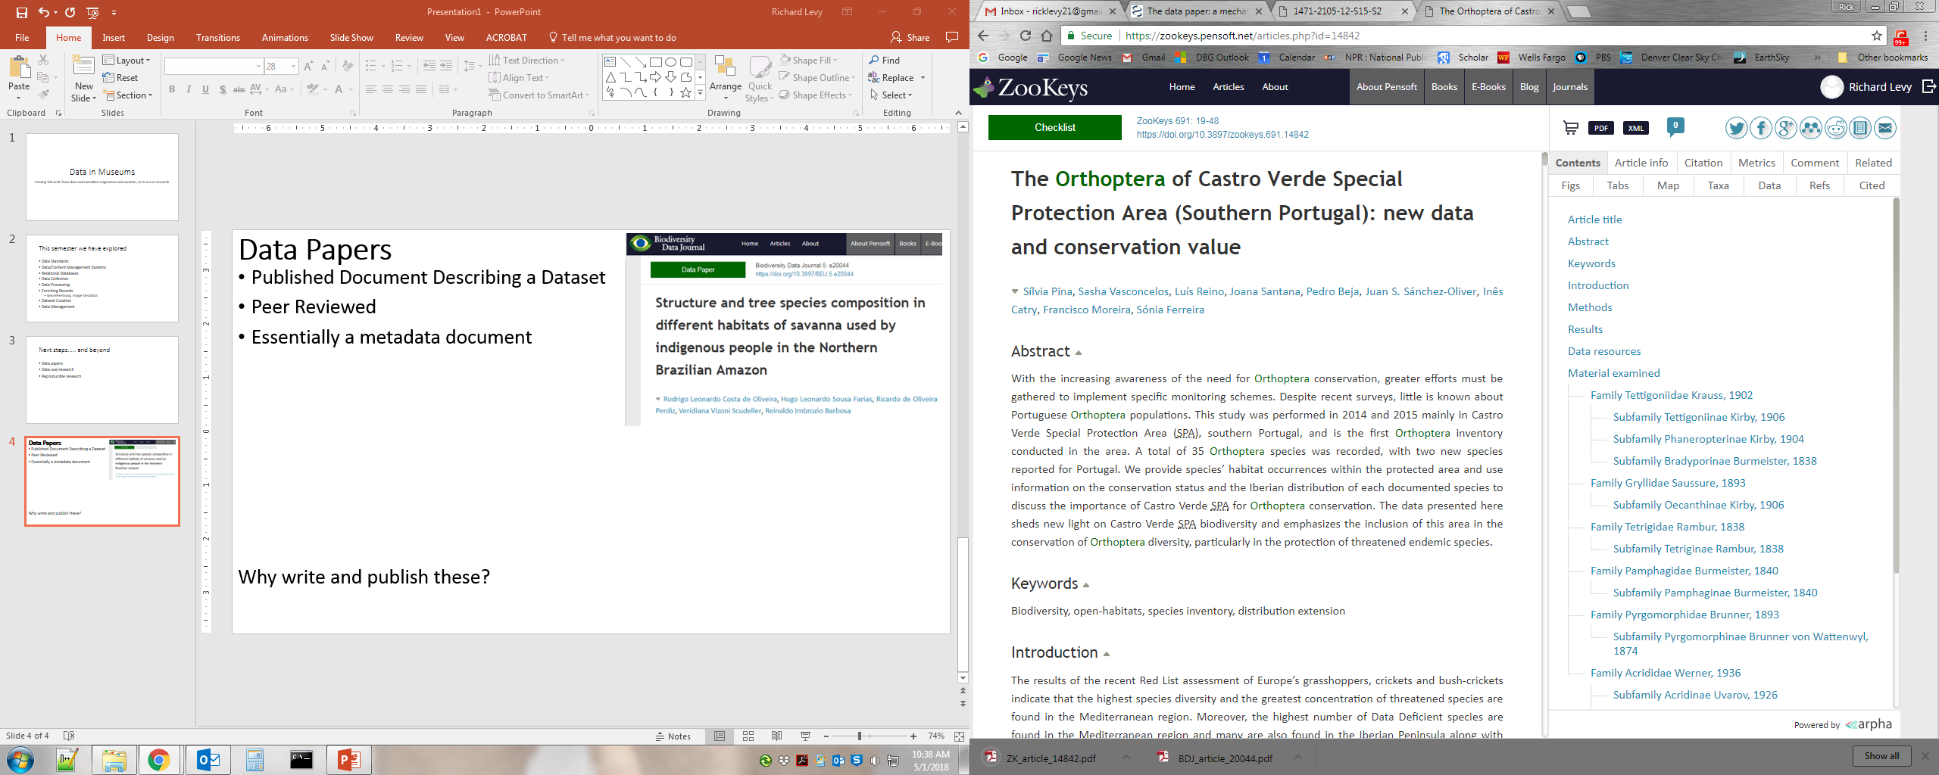
Data Papers
Published Document Describing a Dataset
Peer Reviewed
Essentially a metadata document
Why write and publish these?

Slide 5
Tools for writing data papers
IPT!
NephilaPaper
arpha Writing Tool

Slide 6
Journals Publishing Data Papers
Arxius de Miscel·lània Zoològica
Biodiversity Data Journal
BioInvasions Records
BioRisk
Biota Colombiana
BMC Ecology
BMC Plant Biology
Botanical Studies
Check List
China Scientific Data
Data in Brief
Data
Earth System Science Data
F1000 Research
The Freshwater Metadata Journal
Geoscience Data Journal
GigaScience
MycoKeys
Nature Conservation
NeoBiota
PhytoKeys
PLOS ONE
Scientific Data
Taxon
ZooKeys
Global Ecology and Biogeography
Ecological Archives
from GBIF April 2018

Slide 7
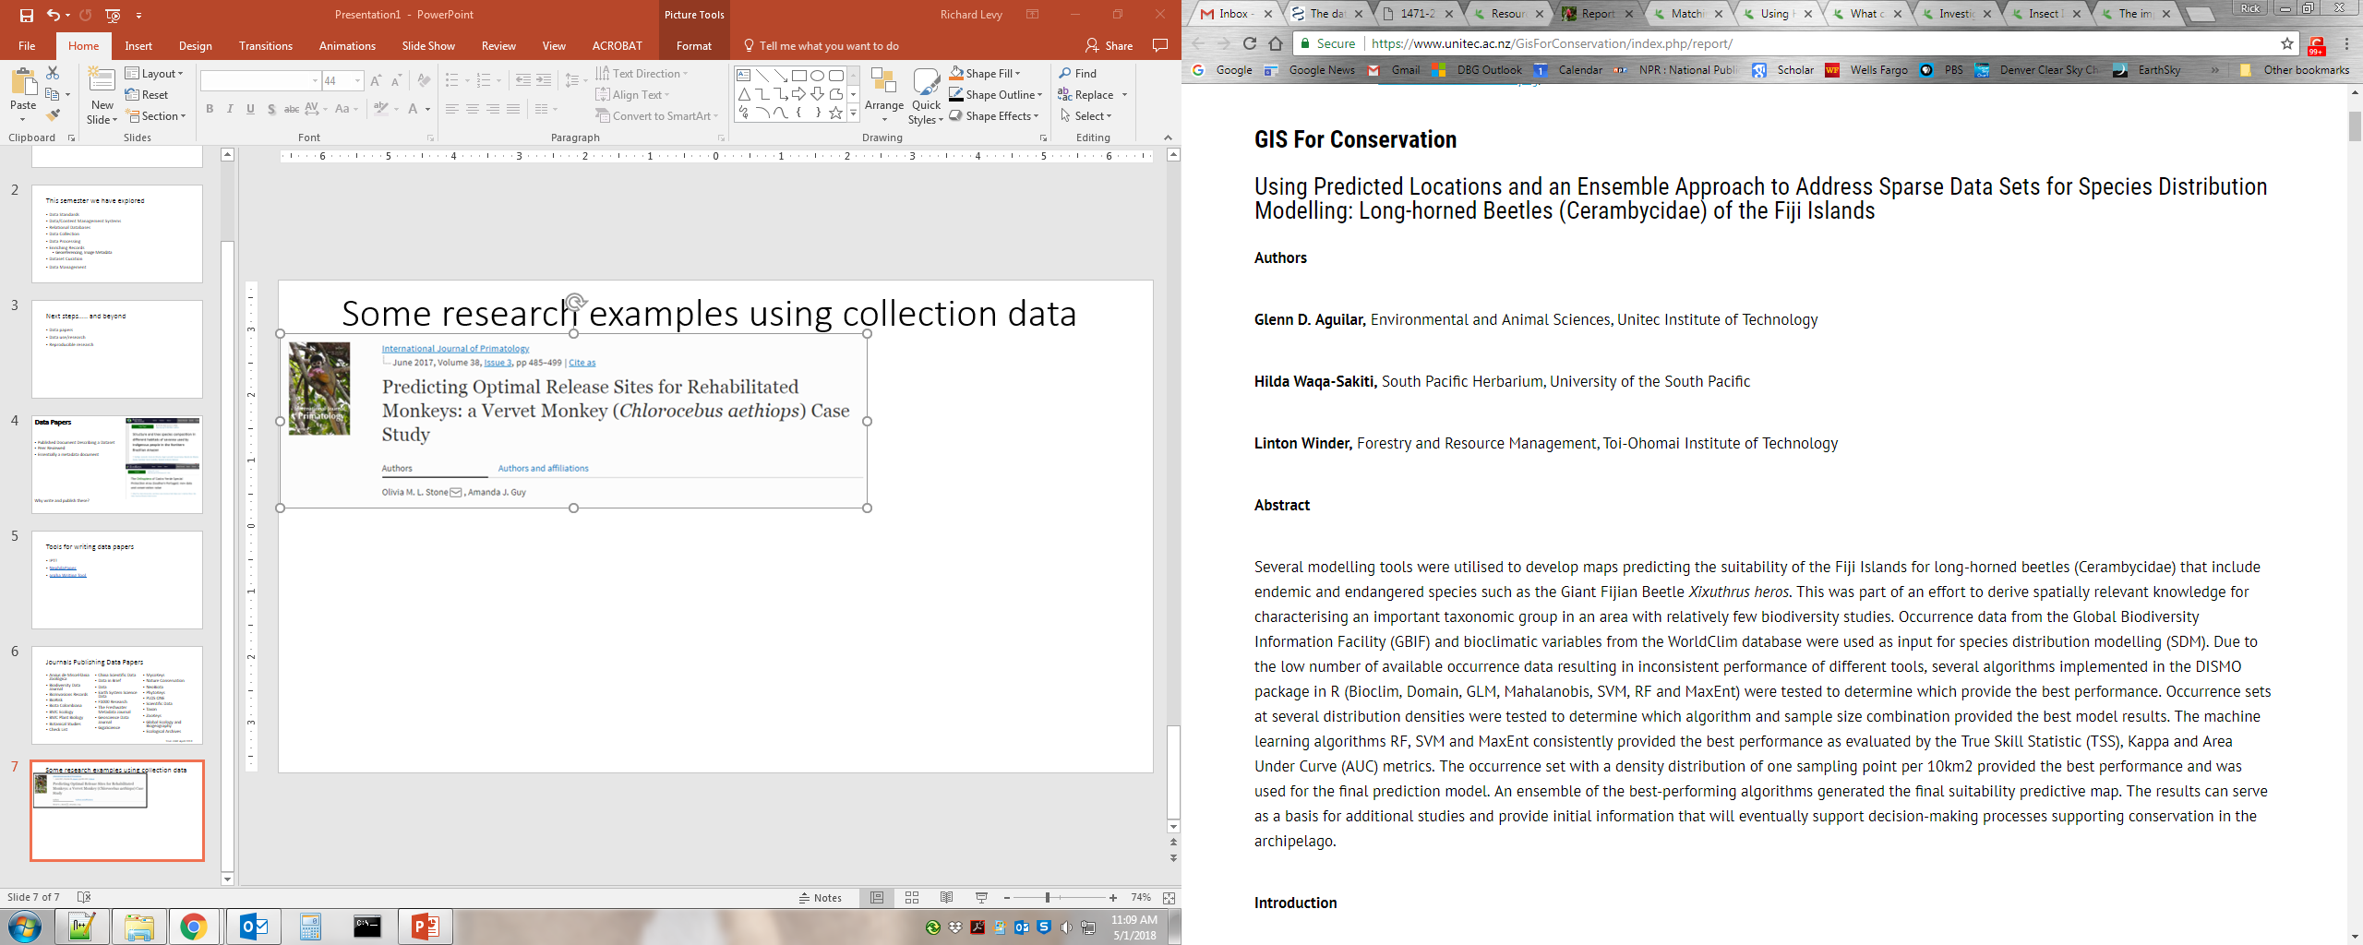
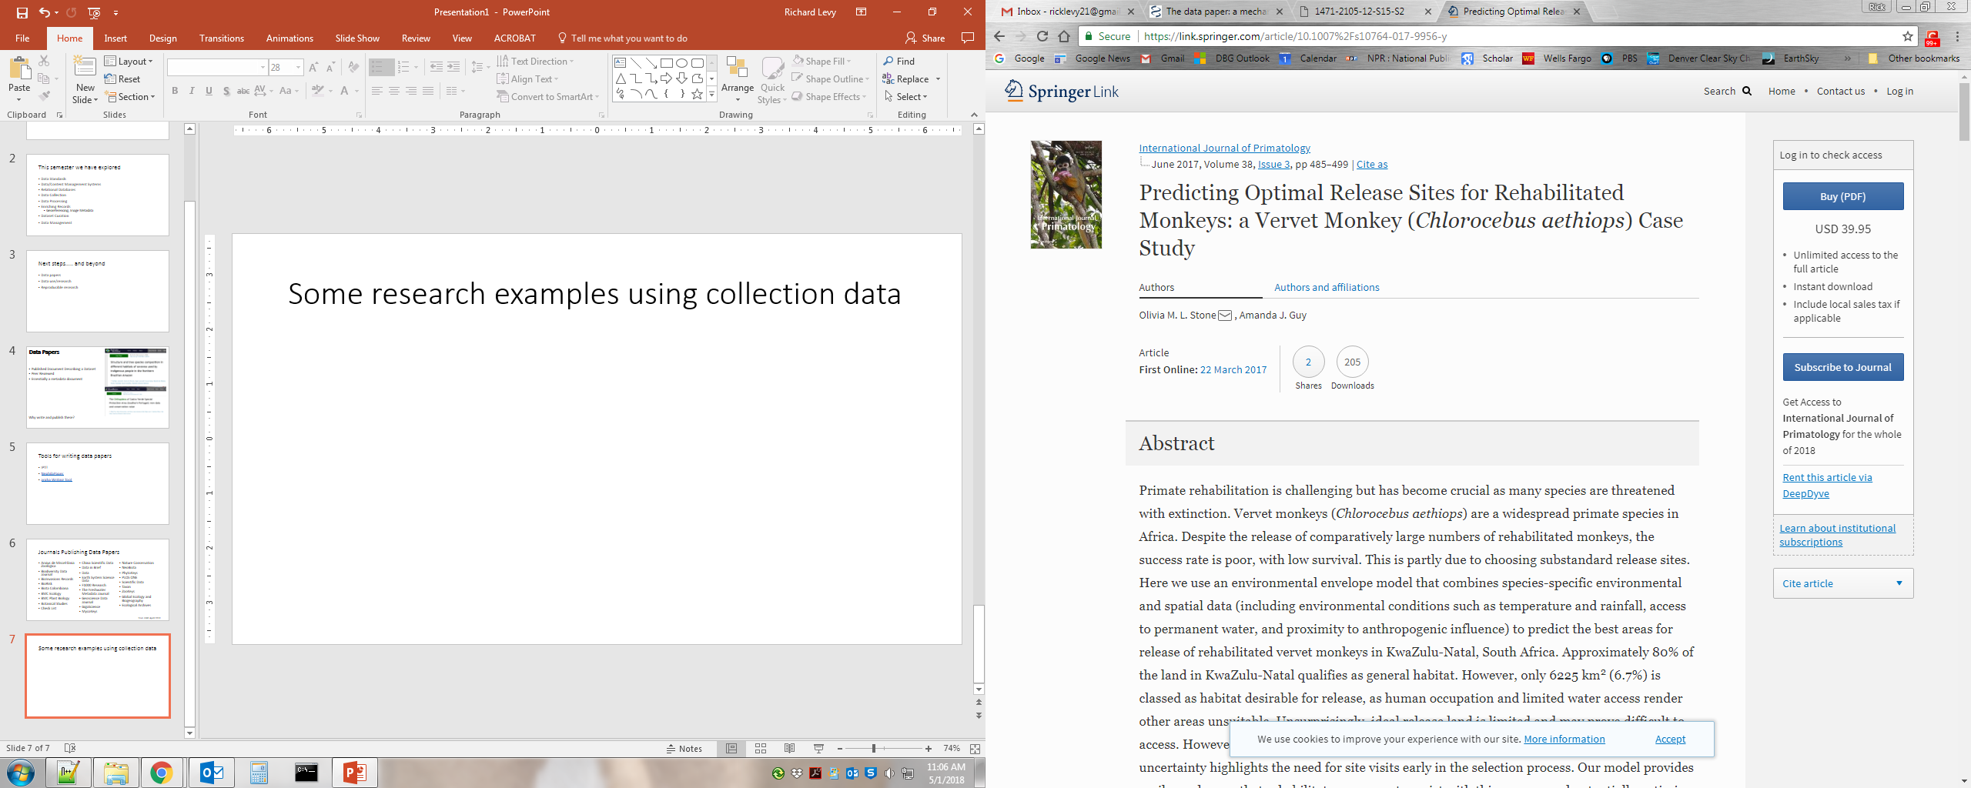
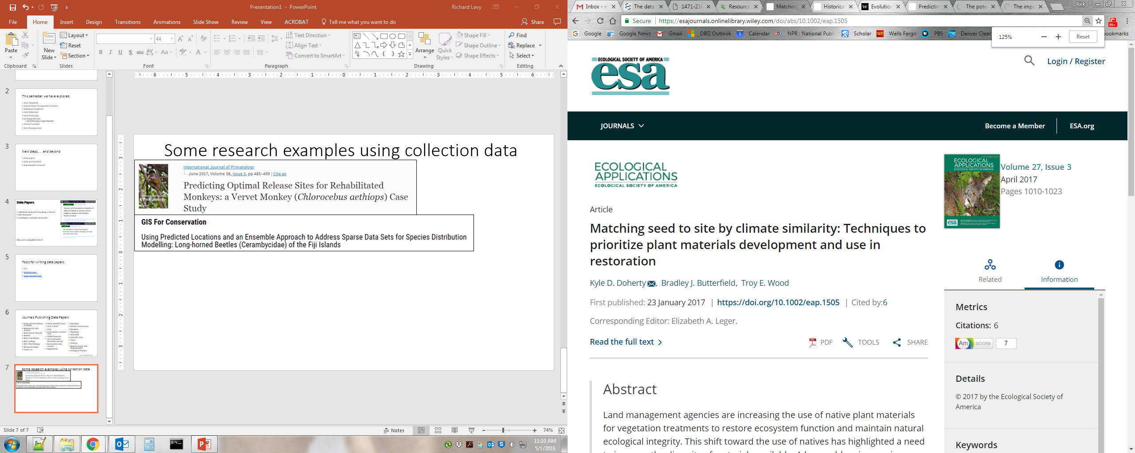
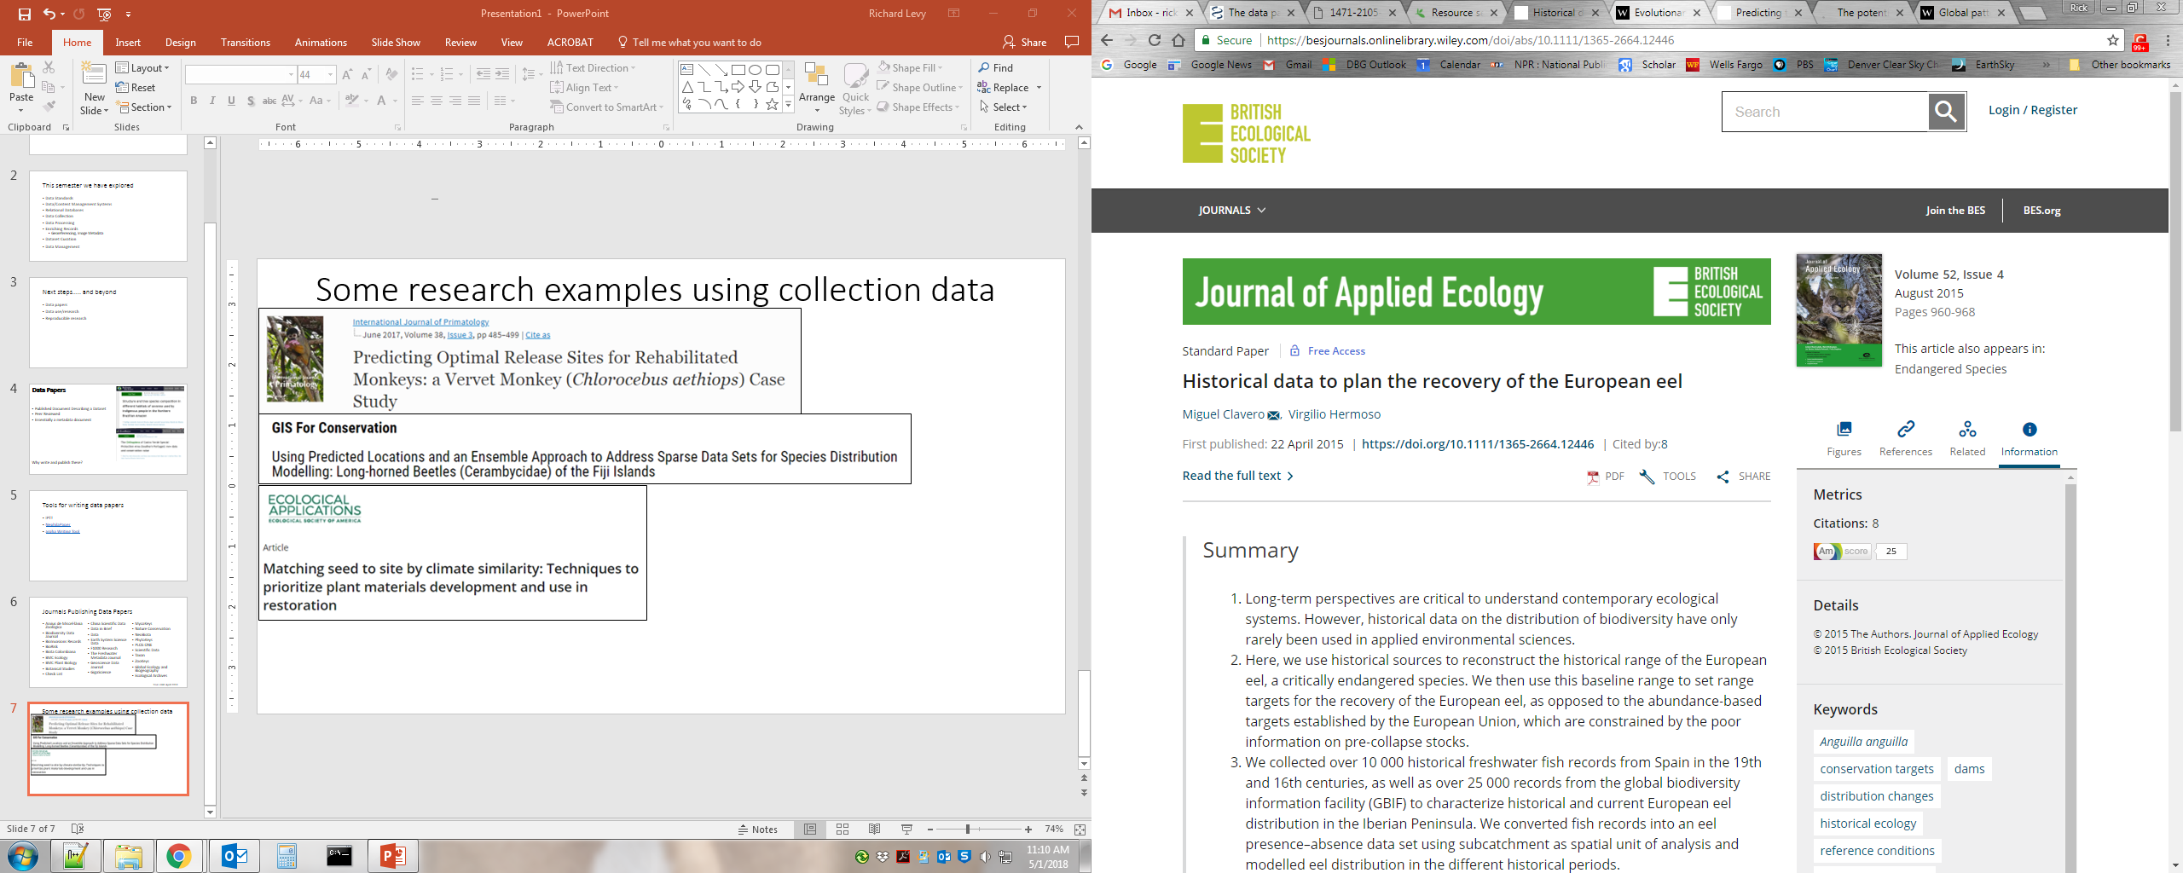
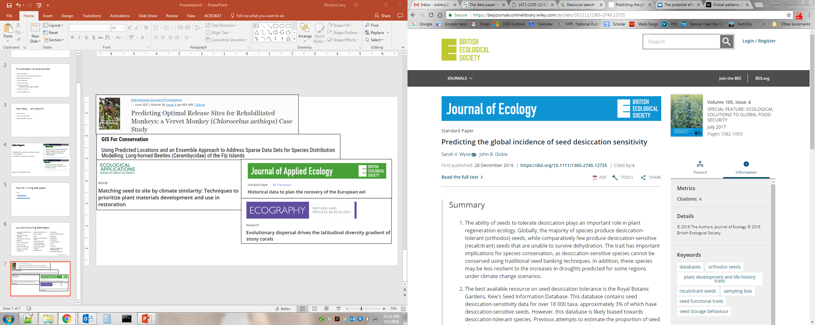
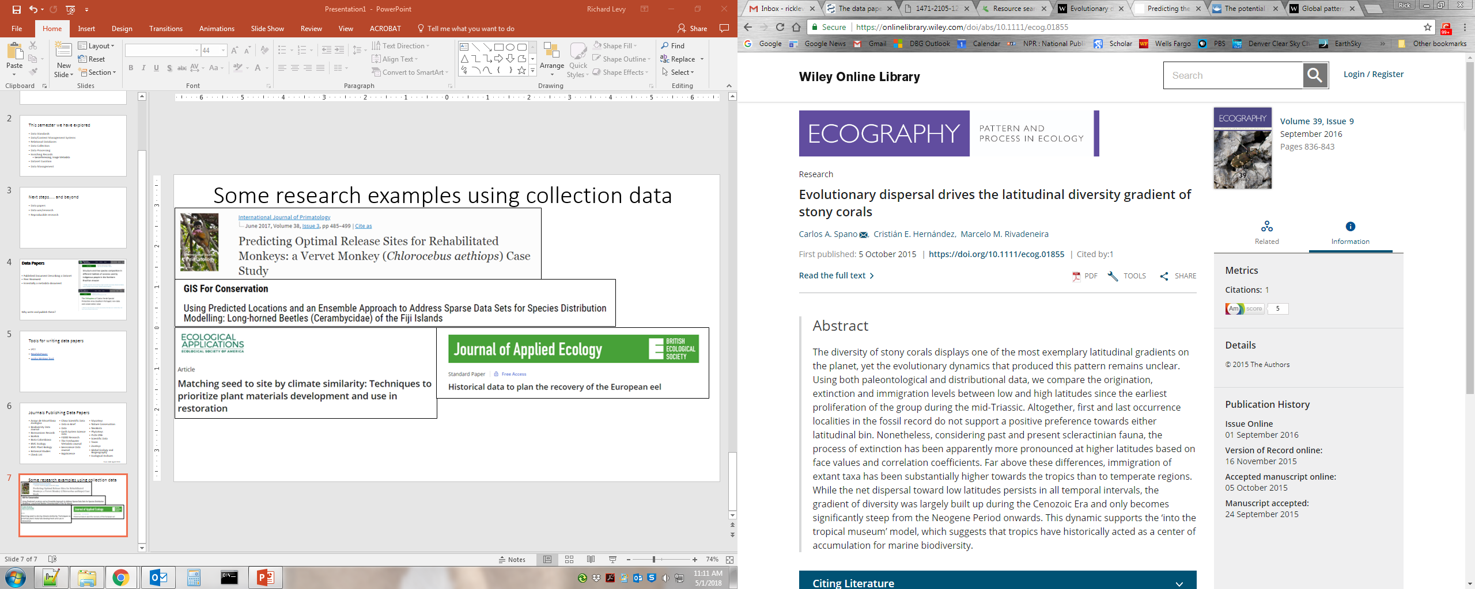
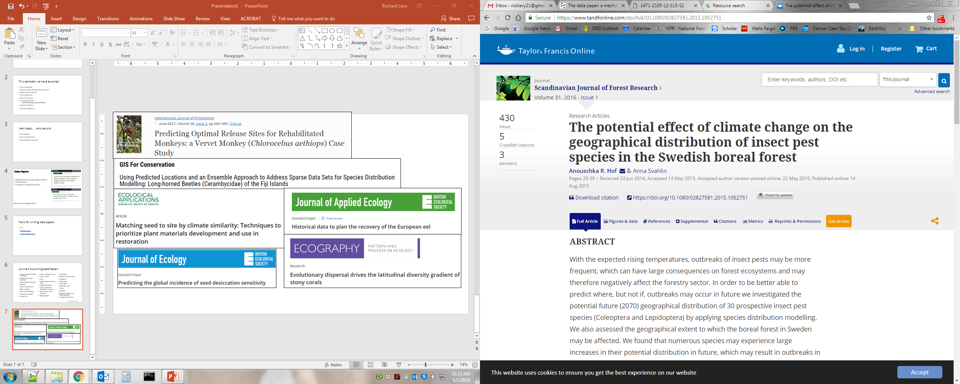

Slide 8
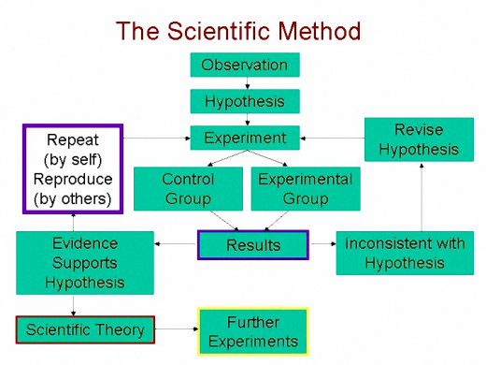
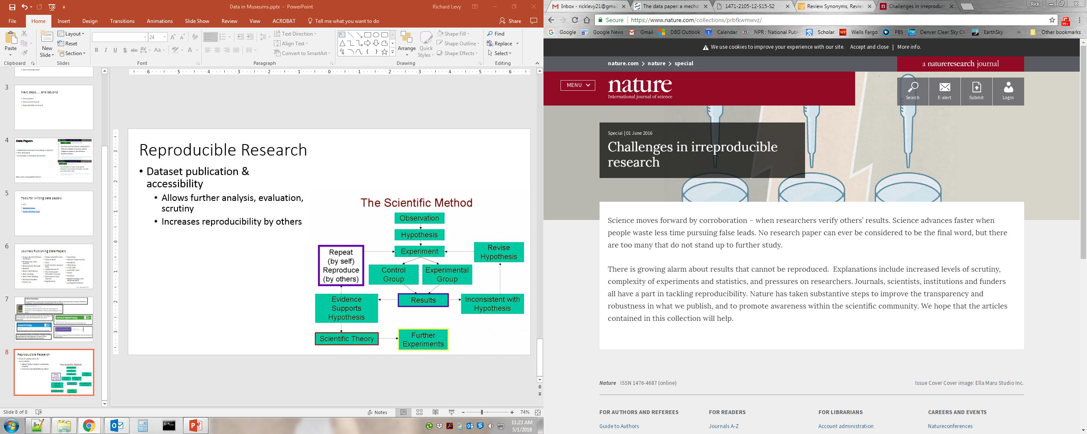
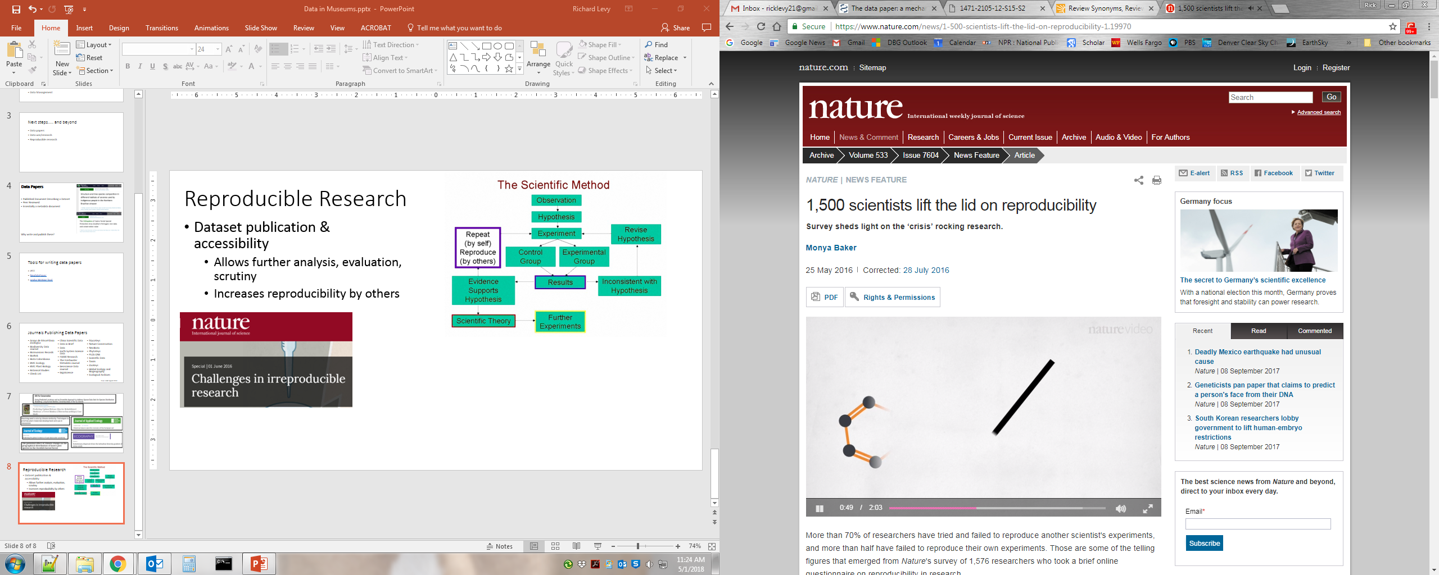
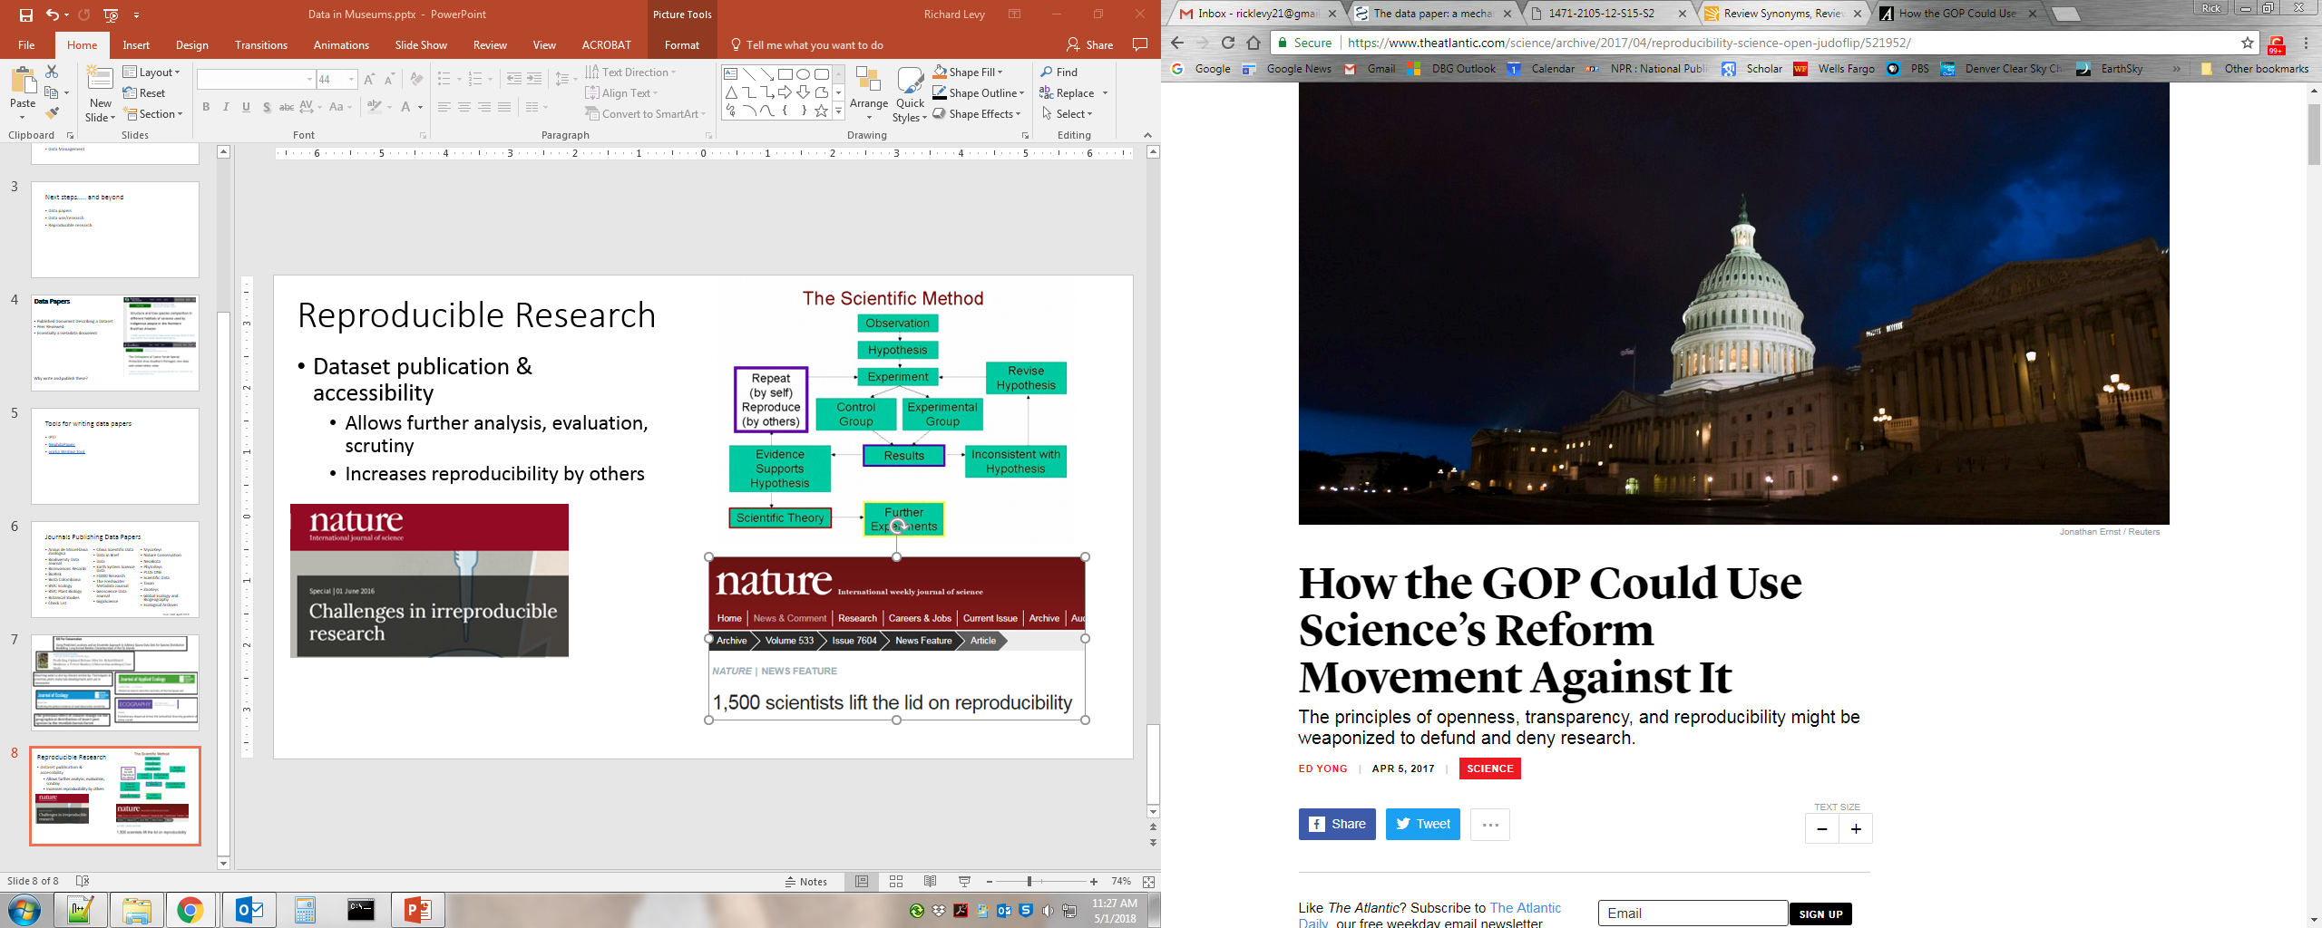
Reproducible Research
Dataset publication & accessibility
Allows further analysis, evaluation, scrutiny
Increases reproducibility by others

Slide 9



R Markdown for Reproducible Science
R Statistical Language
Markdown: A markup language for text to HTML
A development environment for R

Slide 10
